Slide 1
Library Management System (LMS) -Capstone Project
Subtitle: Full Stack Web Development Project
Presented by: Karen Chan
Date: 1st April 2025

Slide 2
Project Overview
📌 What is the Library Management System (LMS)? A web application designed to streamline library operations, making it easier to manage books, members, and transactions.
🧑‍💼 User Roles & Functionalities
Librarian (Admin): Manages books, members, and lending records.
Member: Searches for books, borrows/returns them, and views loan history.

Slide 3
Project Overview
🛠 Technology Stack
Backend: Spring Boot
Frontend: React
Database: MySQL

Slide 4
Project Goals
🎯 Our Objectives
✅ Develop a Fully Functional Web Application
Ensure seamless library operations with essential features.
✅ Efficient Management for Librarians
Enable book cataloging, member management, and transaction tracking.
✅ User-Friendly Experience for Members
Easy book search, borrowing history tracking, and smooth navigation.
✅ Build a Robust & Scalable System
Designed for future growth, handling increased data and users efficiently.

Slide 5
Key Features
📌 Enhancing Library Operations with Key Functionalities
🔹 User Management
Registration, login, profile updates, and password reset for seamless access.
🔹 Member Management
Librarians can register, edit, delete, and search for members efficiently.
🔹 Book Management
Add, update, delete, and search for books to maintain an organized catalog.
🔹 Lending Management
Borrow, return, and reserve books with automated due date tracking.

Slide 6
Key Features
🚀 How These Features Help:
Streamlined processes for librarians.
Improved accessibility for members.
Efficient tracking of books and transactions.

Slide 7
Technical Requirements
🖥 Backend Technologies
Spring Boot – Robust and scalable backend framework.
RESTful API – Ensures smooth communication between frontend and backend.
MySQL – Reliable relational database for structured data storage.
JPA/Hibernate – Simplifies database interactions with ORM.

Slide 8
Technical Requirements
🌐 Frontend Technologies
React.js – Dynamic and responsive UI.
React Router – Enables seamless navigation.
React Hooks – Efficient state management.
Bootstrap/Material-UI – Enhances UI design and responsiveness.
Axios – Handles API requests efficiently.

Slide 9
Technical Requirements
🗄 Database Considerations
Proper Relationship Mapping – Maintains structured and linked data.
Referential Integrity – Prevents orphaned records and ensures consistency.
Indexing & Data Validation – Optimizes queries and maintains data accuracy.

Slide 10
Technical Requirements
🔐 Why These Choices?
Security: Protects user data with authentication and authorization.
Performance: Ensures fast and efficient processing.
Scalability: Supports future growth and increased data volume.

Slide 11
System Architecture
🏗 Chosen Architecture: MVC (Model-View-Controller)
🔹 Model (M) – Handles data and business logic. (Spring Boot + JPA/Hibernate) 🔹 View (V) – Manages the user interface. (React.js + Bootstrap/Material-UI) 🔹 Controller (C) – Processes requests and connects Model & View. (Spring Boot REST API)

Slide 12
System Architecture
🛠 Why MVC? ✅ Separation of Concerns – Clear distinction between data, logic, and UI. ✅ Scalability – Easy to extend and maintain. ✅ Efficient Development – Parallel work on frontend & backend.

Slide 13
System Architecture
🚀 How It Helped?
Simplified code organization and maintenance.
Enabled faster development by dividing responsibilities.
Improved user experience with a dynamic frontend and powerful backend.

Slide 14
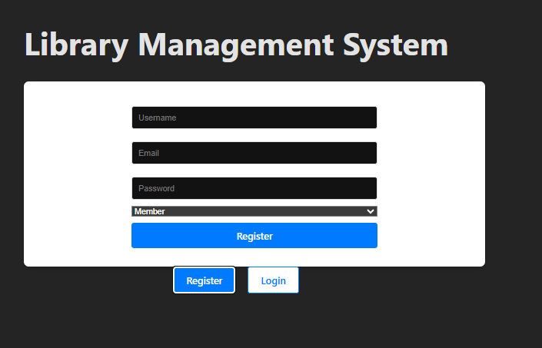
Screenshots of Registration and Login
Registration
Allow user to login

Slide 15
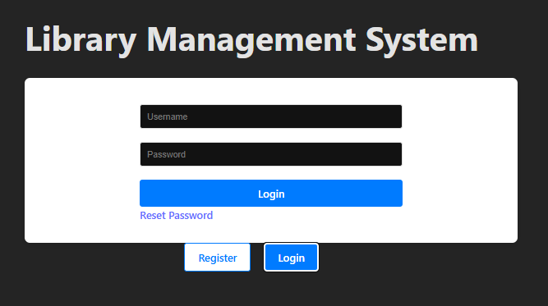
Screenshots of Registration and Login
Login
Allow user to login

Slide 16
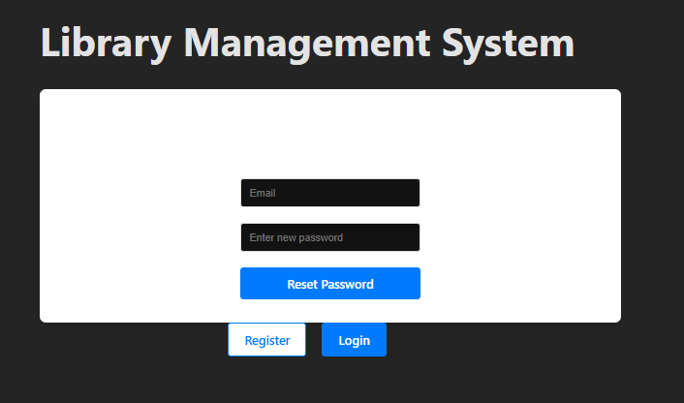
Screenshots of Registration and Login
Reset Password
Allow user to reset password

Slide 17
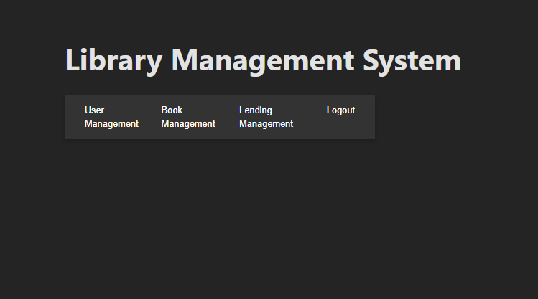
Screenshots of Admin Portal
Admin Portal
Central dashboard for managing books, members, and lending operations.
Provides insights into system activities and overdue books.

Slide 18
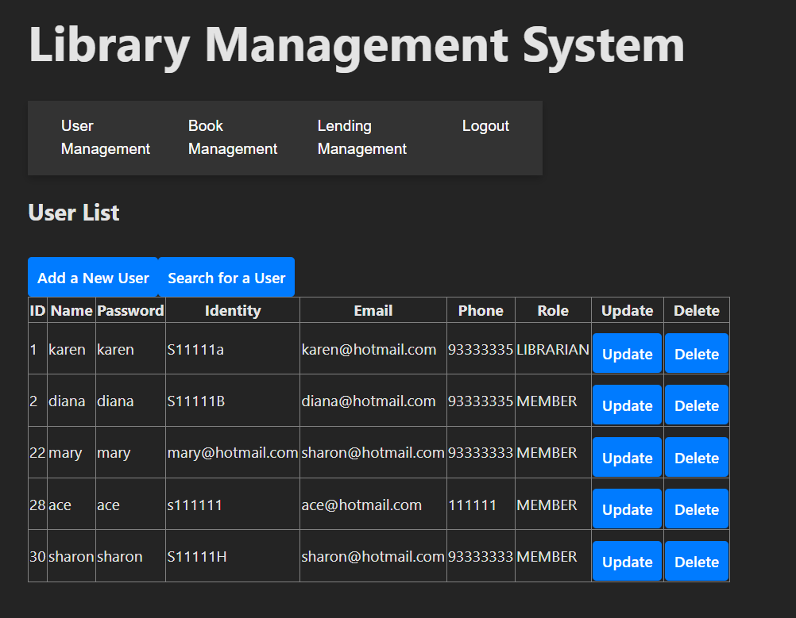
Screenshots of Admin Portal
User Managment
Features: Add / Search /Update / Delete

Slide 19
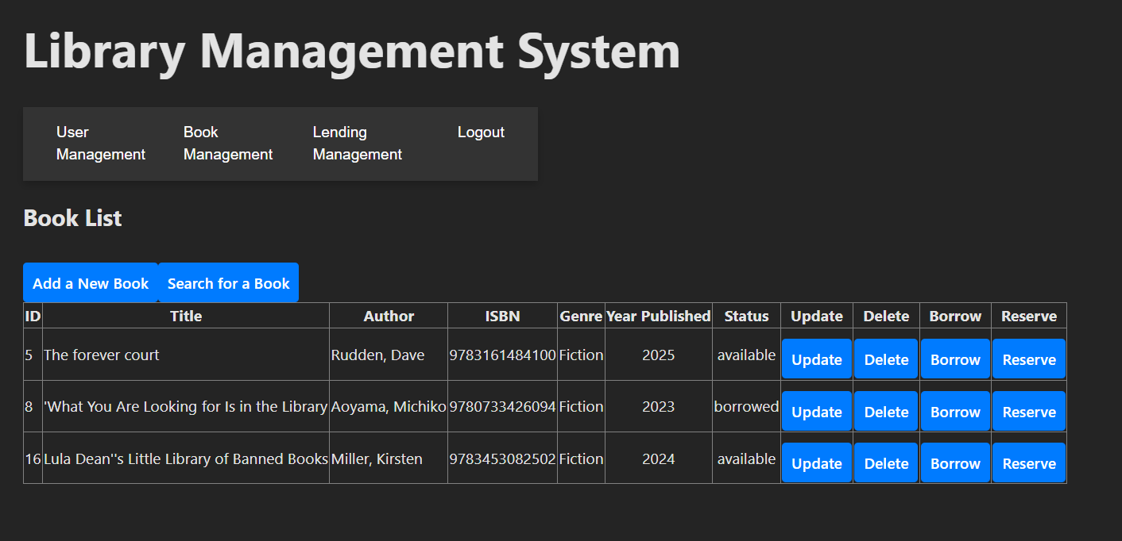
Screenshots of Admin Portal
Book Management
Features: Add / Search /Update / Delete/ Borrow / Return / Reserve

Slide 20
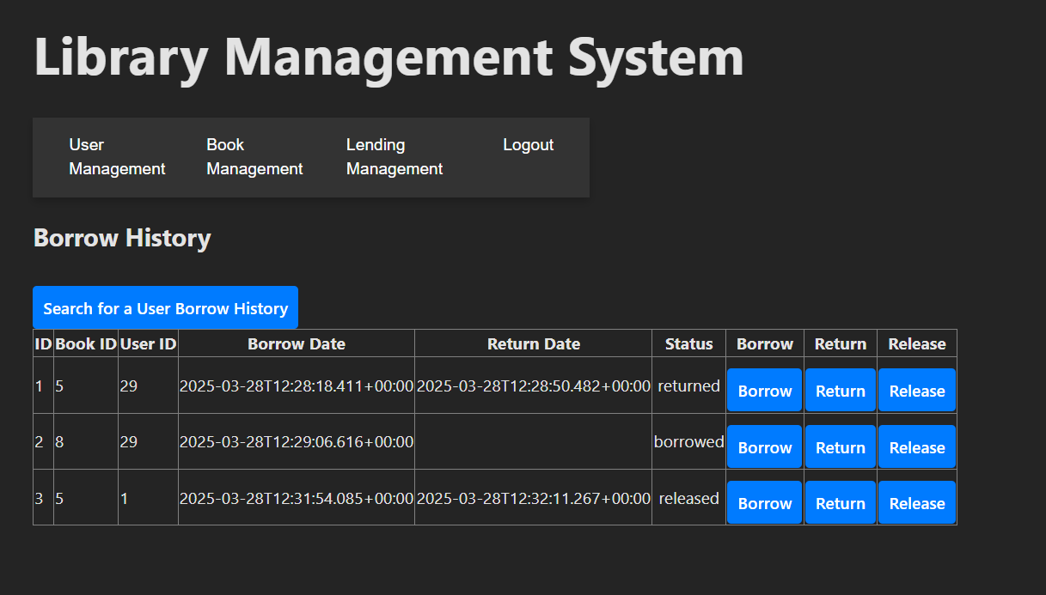
Screenshots of Admin Portal
Lending Management
Features: Borrow / Return / Release

Slide 21
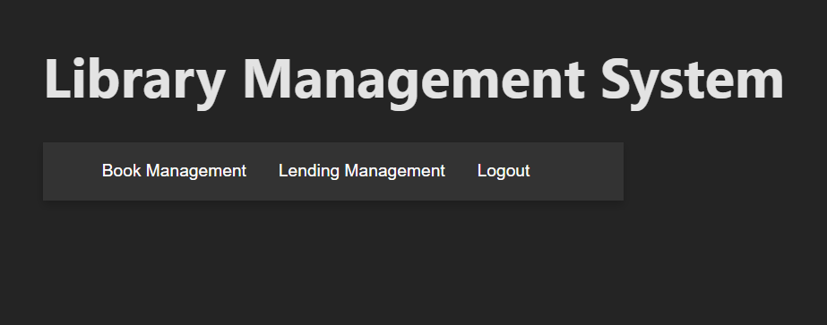
Screenshots of Member Portal
User-friendly interface for members to interact with the system.
Displays personal details, borrowed books, and due dates.
Member Portal
User-friendly interface for members to interact with the system.
Displays personal details, borrowed books, and due dates.

Slide 22
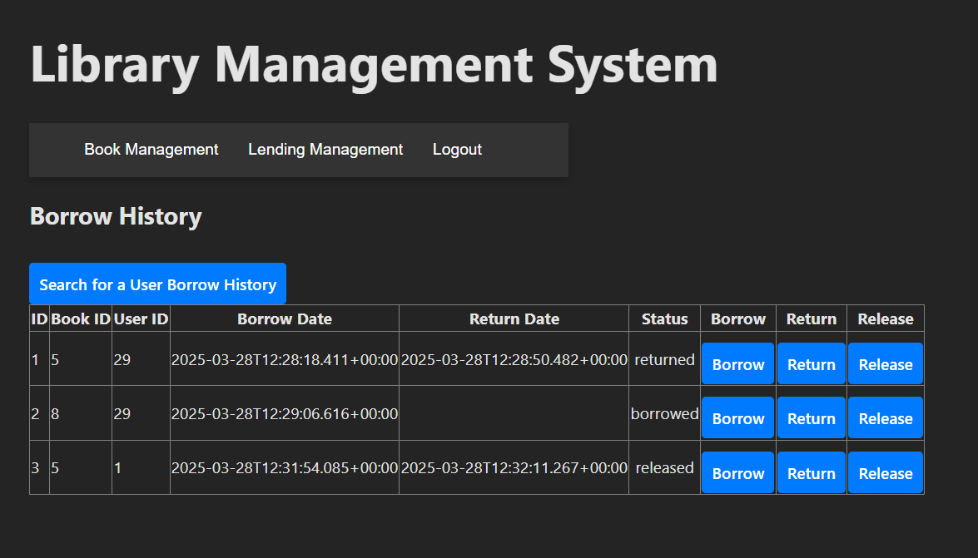
Screenshots of Member Portal
User-friendly interface for members to interact with the system.
Displays personal details, borrowed books, and due dates.
Book Management
Features: Search / Borrow / Return / Reserve

Slide 23
Screenshots of Member Portal
User-friendly interface for members to interact with the system.
Displays personal details, borrowed books, and due dates.
Lending Management
Features: Borrow / Return / Release

Slide 24
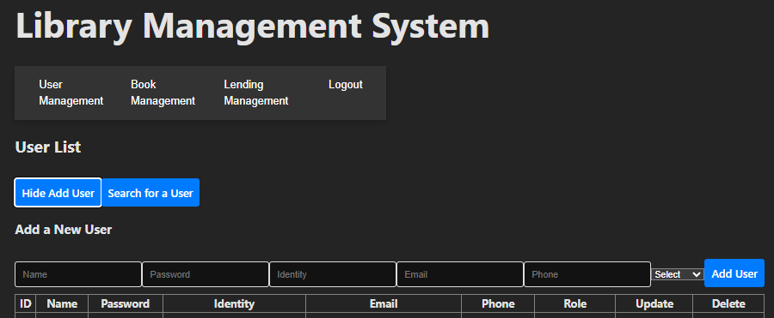
Screenshots of User Management
User Management
Allows librarians to add members.

Slide 25
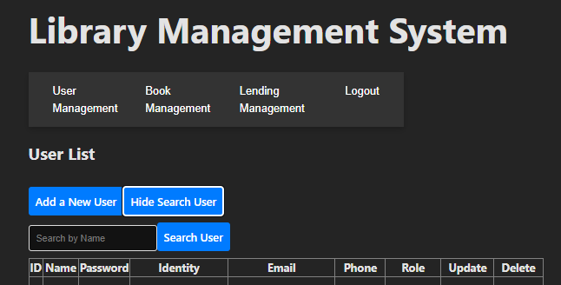
Screenshots of User Management
User Management
Allows librarians/members to search members.

Slide 26
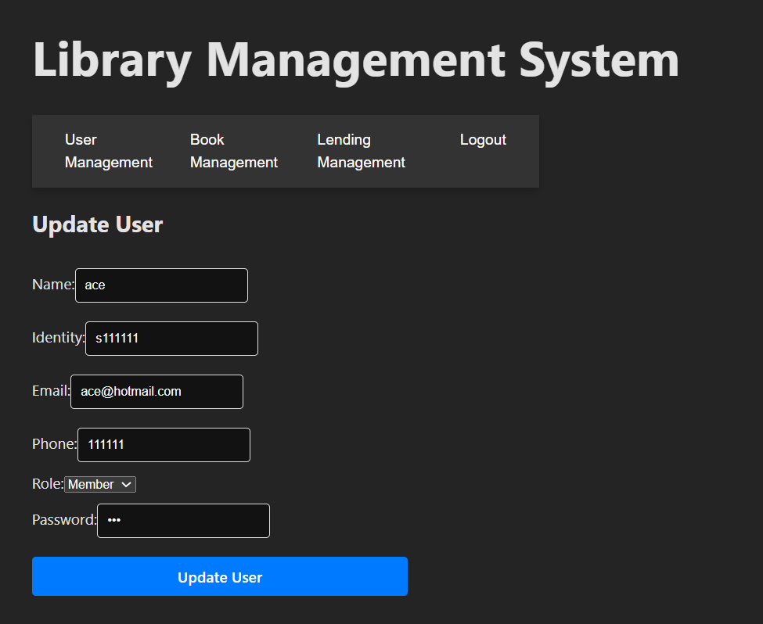
Screenshots of User Management
User Management
Allows librarians to update members

Slide 27
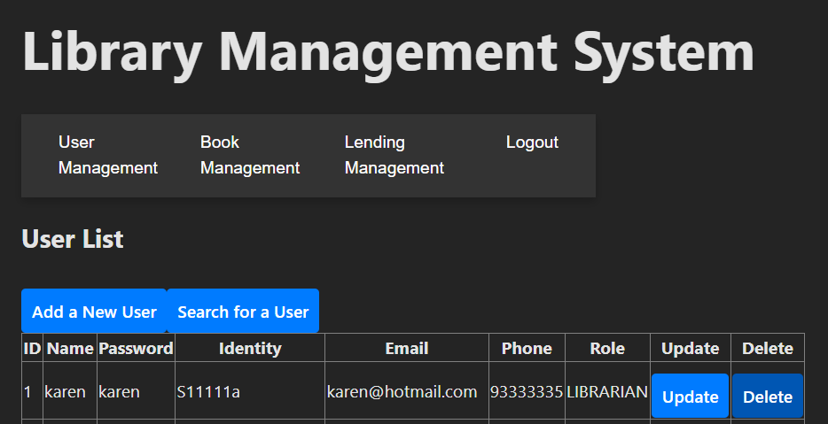
Screenshots of User Management
User Management
Allows librarians to delete members. The member will be removed from the list.

Slide 28
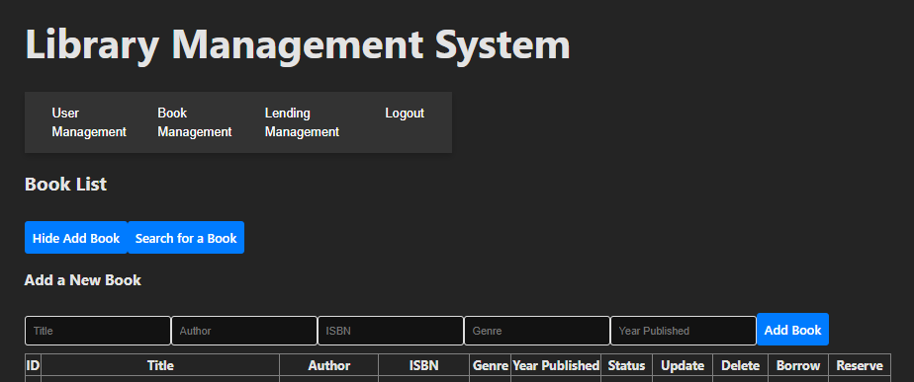
Screenshots of Book Management
Book Management
Enables librarians to add books.

Slide 29
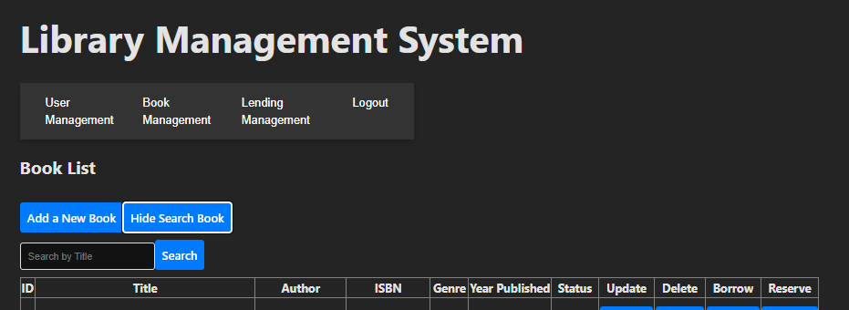
Screenshots of Book Management
Book Management
Enables librarians/members to search books.

Slide 30
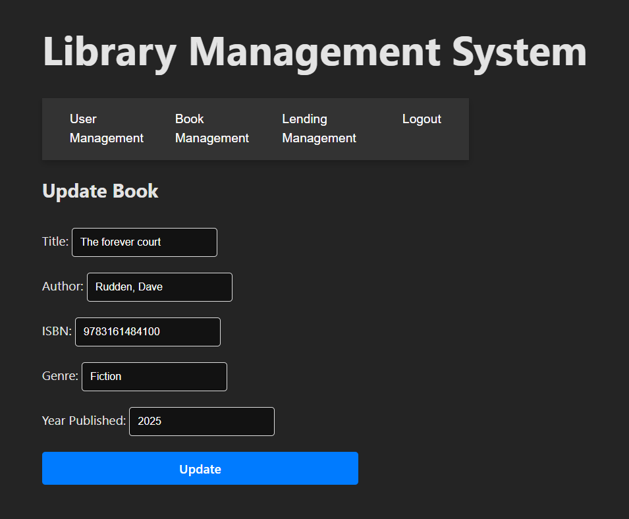
Screenshots of Book Management
Book Management
Enables librarians to update books.

Slide 31
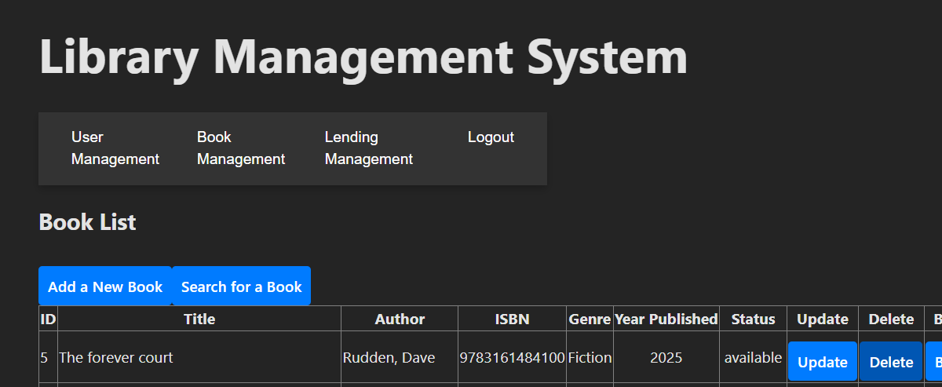
Screenshots of Book Management
Book Management
Enables librarians to delete books. Book will be removed from the list

Slide 32
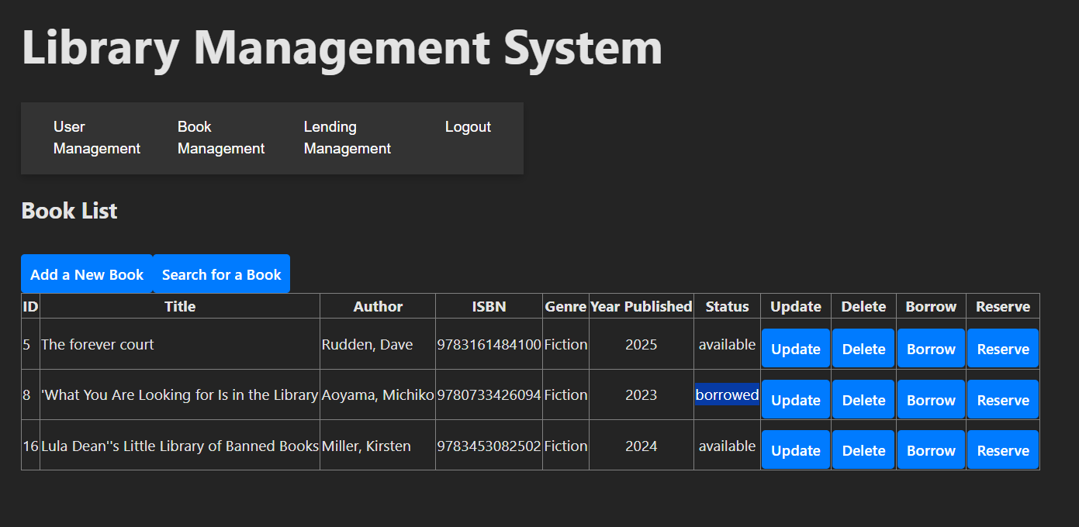
Screenshots of Book Management
Book Management
Enables librarians/members to borrow books. Status will change to borrowed

Slide 33
Screenshots of Book Management
Book Management
Enables librarians/members to reserve books. Status will change to reserved.

Slide 34
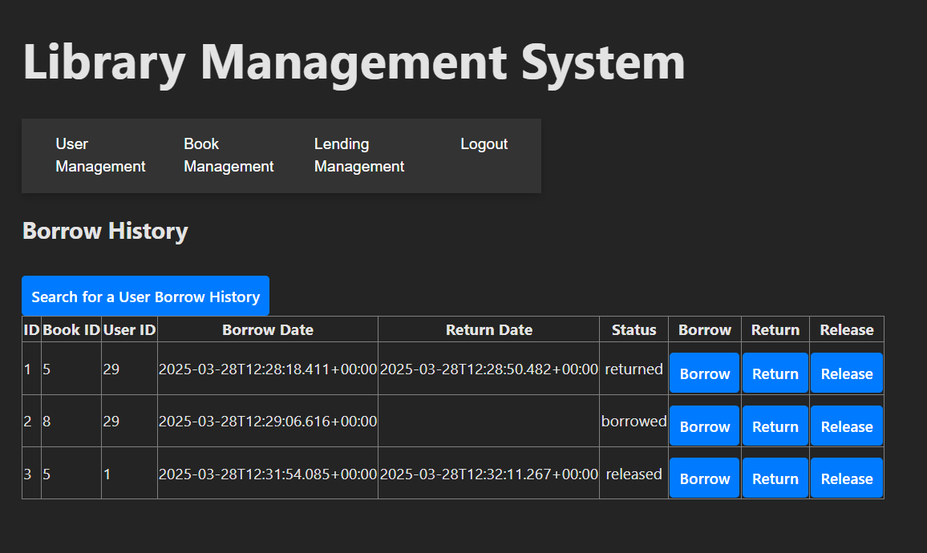
Screenshots of Lending Management
Lending Management
Enables librarians/members to
Borrow (status change to borrow)
Return (status change to returned)
Release (status change to released).

Slide 35
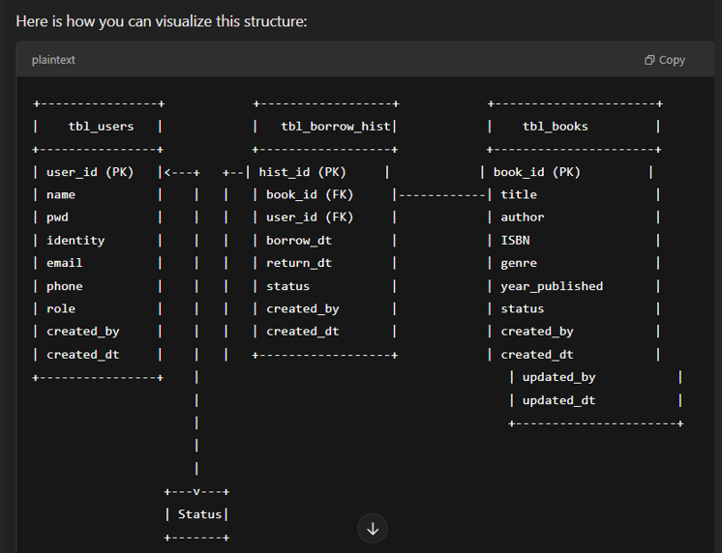
Database & System Designs

Slide 36
Database & System Designs
📌 Entity-Relationship Diagram (ERD) Overview
Main Entities & Relationships:
Tbl_users (Members & Librarians) → Can register, log in, and manage accounts.
Tbl_books → Linked to authors, categories, and availability status.
Tbl_borrow_hist (Lending/Returning) → Tracks book loans,

Slide 37
Database & System Designs
📌 Wireframes & Prototypes 🔹 Overall Library System
Showcases the user journey from login to book management and borrowing.
🔹 Key Features in Design:
User Registration/Login → Secure authentication process.
Book Management → Interface for adding, updating, and searching books.
Member Dashboard → Displays borrowing history and account details.

Slide 38
API endpoints
📌 3.1 User Registration & Authentication 🔹 AuthController
GET http://localhost:9000/api/auth → Handles authentication-related actions.
🔹 PasswordResetController
GET http://localhost:9000/api/passwordreset → Endpoint for password reset functionality.
📌 3.2 User Management 🔹 UserController
GET /POST http://localhost:9000/api/users → Fetch or register users.

Slide 39
API endpoints
📌 Book Management 🔹 BookController
GET /POST http://localhost:9000/api/books → Retrieve book details or add new books.
📌 Lending Management 🔹 BorrowHistoryController
GET /POST http://localhost:9000/api/borrowhistory → View or log borrowing history.

Slide 40
Test Cases - UATs

Slide 41
Challenges & Solutions
📌 1. Integrating Frontend and Backend Challenge: Ensuring seamless communication between React (frontend) and Spring Boot (backend). Solution: Used Axios for API requests, followed RESTful principles, and implemented CORS configurations to allow smooth data exchange.

Slide 42
Future Enhancements
📱 Mobile App Integration
What: Develop a mobile app for both Android and iOS to provide easy access for users on the go.
Why: Enhances user experience, making it more convenient for members to browse books, track borrowing history, and manage their profiles from their phones.

Slide 43
Future Enhancements
🔍 Advanced Search & Recommendation System
What: Implement an AI-based recommendation engine that suggests books based on user preferences, borrowing history, and ratings.
Why: Makes searching more intuitive and personalized, improving member engagement and satisfaction.

Slide 44
Future Enhancements
🔗 Integration with External Libraries or APIs
What: Integrate with external library databases or third-party APIs (e.g., Google Books API, Open Library API) for broader book catalogs and metadata.
Why: Expands book availability and enhances the system's search capabilities with more comprehensive data.

Slide 45
Future Enhancements
📊 Enhanced Reporting & Analytics for Librarians
What: Provide advanced reporting tools to track borrowing trends, overdue books, and member activity.
Why: Helps librarians make data-driven decisions for better resource management, stock optimization, and member engagement.

Slide 46
Future Enhancements
🎯 How These Enhancements Improve the System:
Mobile app allows more accessibility for users, increasing engagement.
Advanced search and recommendations will make it easier for members to discover new books.
External integrations will expand book availability and system scalability.
Enhanced analytics will provide better management insights for librarians.

Slide 47
Conclusion
📌 Project Summary The Library Management System (LMS) was developed as a web application to streamline library operations. The system efficiently manages books, users, and transactions, ensuring a seamless experience for both librarians and members. It was built using Spring Boot, React.js, and MySQL, with a focus on security, scalability, and user experience.

Slide 48
Conclusion
📌 Key Achievements
Seamless integration of frontend (React) and backend (Spring Boot).
Efficient role-based access control to manage librarian and member functionalities.
Automated lending and fine calculations for a smooth library operation.
Robust database design ensuring data integrity and efficient management.
Secure authentication and data validation using Spring Security and JWT.

Slide 49
Conclusion
📌 Future Enhancements
Mobile app integration for on-the-go access.
Advanced search and AI-based recommendation system for personalized experiences.
Integration with external library APIs to expand the catalog.
Enhanced reporting and analytics tools to assist librarians in making data-driven decisions.

Slide 50
Conclusion
🎯 Q&A
Thank you for your attention! Feel free to ask any questions or provide feedback. 😊

